Slide 1
Convolution Neural Network

Slide 2
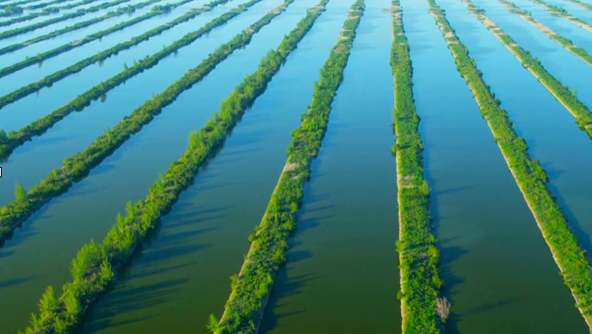
Multiple Input and Output Channels
Slide credit: Alex Smola and Mu Li (Berkley)
courses.d2l.ai/berkeley-stat-157

Slide 3
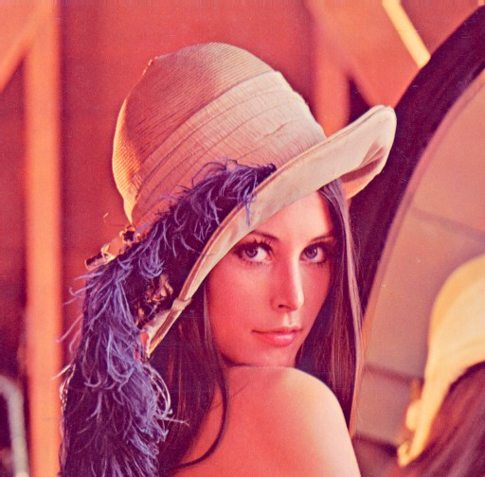
Multiple Input Channels
Color image may have three RGB channels
Converting to grayscale loses information
Slide credit: Alex Smola and Mu Li (Berkley)

Slide 4
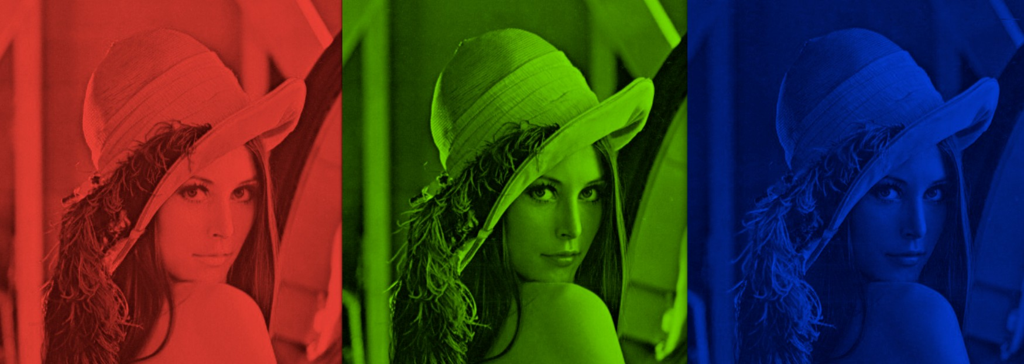

Multiple Input Channels
Color image may have three RGB channels
Converting to grayscale loses information
Slide credit: Alex Smola and Mu Li (Berkley)

Slide 5
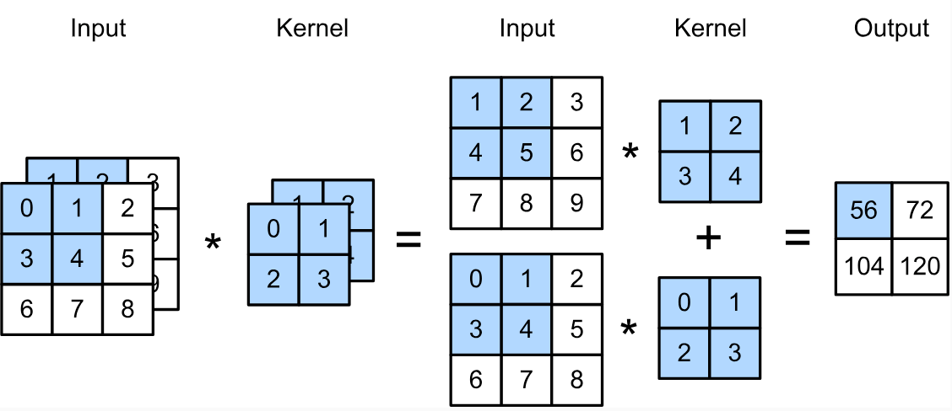
Multiple Input Channels
Have a kernel for each channel, and then sum results over channels
(1 × 1 + 2 × 2 + 4 × 3 + 5 × 4)
+ (0 × 0 + 1 × 1 + 3 × 2 + 4 × 3)
= 56
Slide credit: Alex Smola and Mu Li (Berkley)

Slide 6
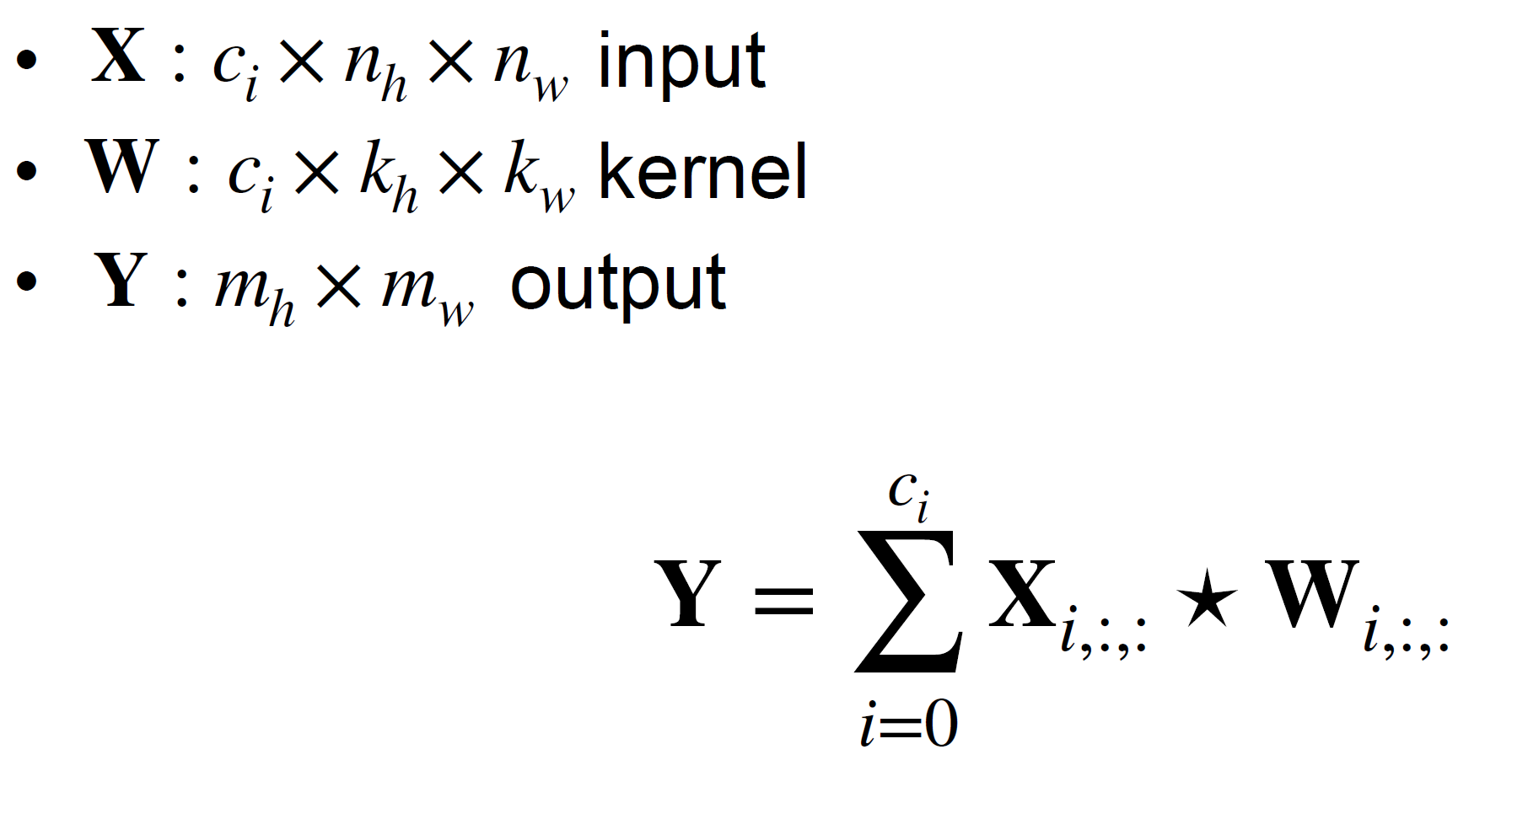
Multiple Input Channels
Slide credit: Alex Smola and Mu Li (Berkley)

Slide 7
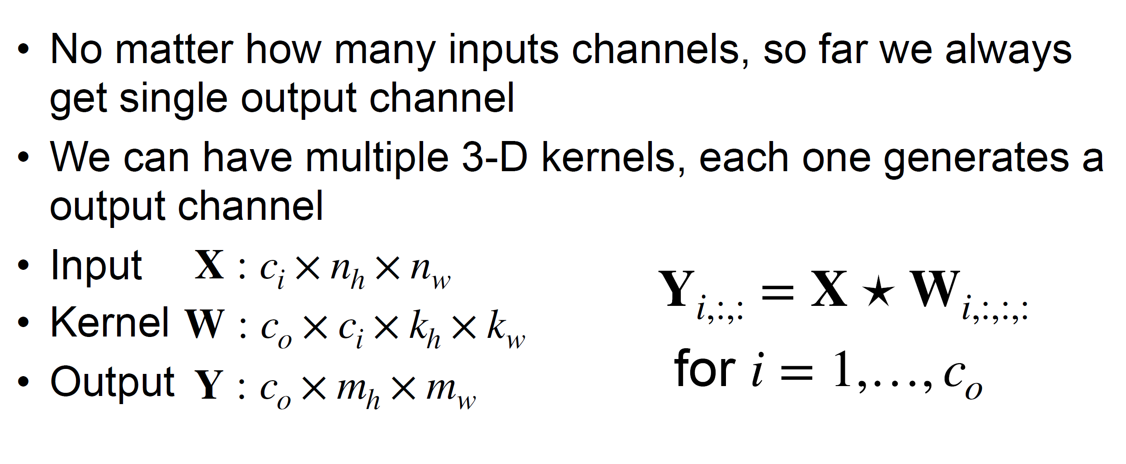
Multiple Output Channels
Slide credit: Alex Smola and Mu Li (Berkley)

Slide 8
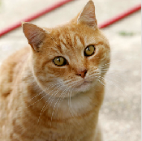
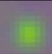
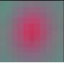

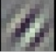
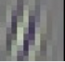

Multiple Input/Output Channels
Each output channel may recognize a particular pattern
Input channels kernels recognize and combines patterns in inputs

Slide 9
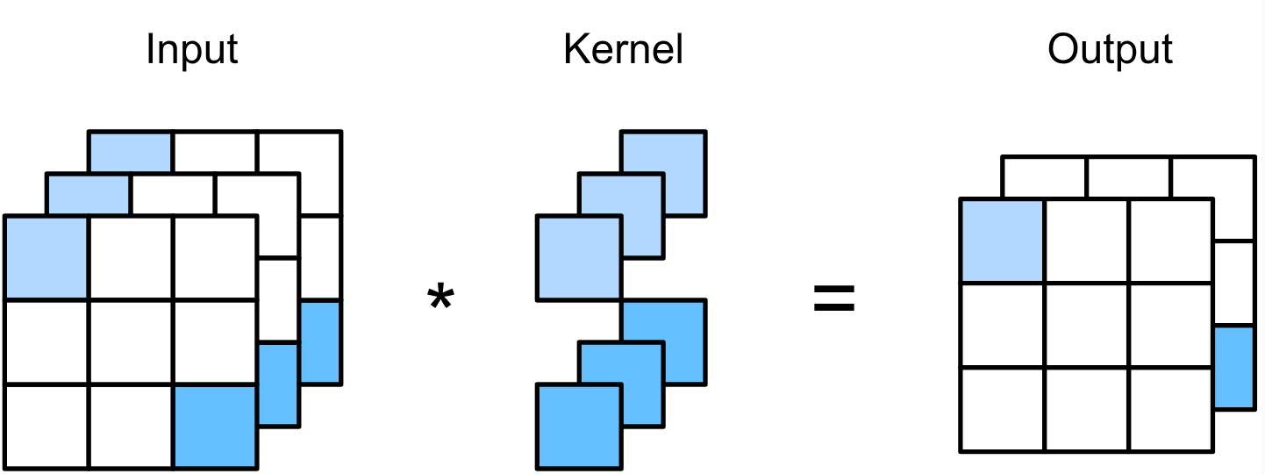
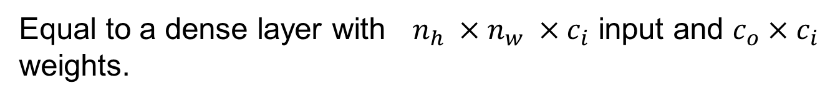
1 x 1 Convolutional Layer
k_{h} = k_{w} = 1 is a popular choice. It doesn’t recognize spatial patterns, but fuse channels.
Equal to a dense layer with $n_{h} ×n_{w} ×c_{i}$ input and $c_{o}×c_{i}$ weights.
Slide credit: Alex Smola and Mu Li (Berkley)

Slide 10
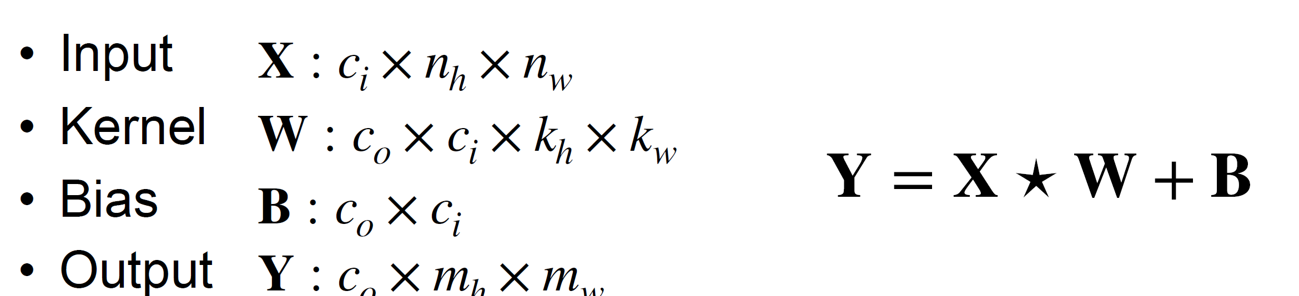
2-D Convolution Layer Summary
Multiple channels can be used to extend the model parameters of the convolutional layer.
The 1×1 convolutional layer is typically used to adjust the number of channels between network layers and to control model complexity
Slide credit: Alex Smola and Mu Li (Berkley)

Slide 11
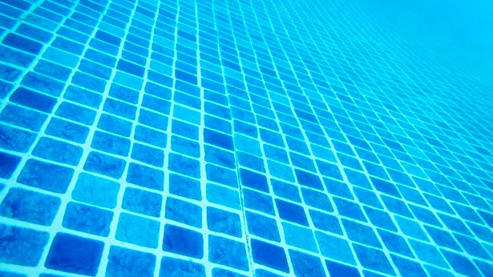
Pooling Layer
Slide credit: Alex Smola and Mu Li (Berkley)
courses.d2l.ai/berkeley-stat-157

Slide 12
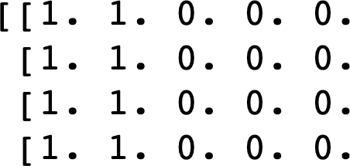
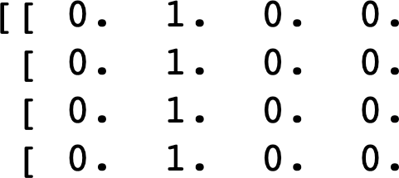
Pooling
Convolution is sensitive to position
Detect vertical edges
0 output with
1 pixel shift
X
Y
We need some degree of invariance to translation
Lighting, object positions, scales, and appearance vary among images
Slide credit: Alex Smola and Mu Li (Berkley)

Slide 13
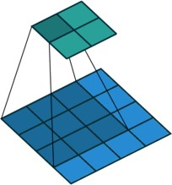
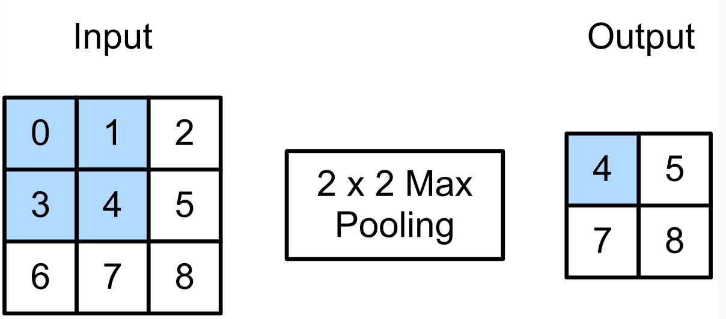
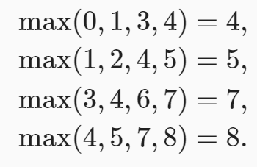
2-D Max Pooling
Returns the maximal value in the sliding window
Pooling layer contains no parameters
Pooling operators are deterministic, typically calculating either the maximum or the average value of the elements in the pooling window.
These operations are called maximum pooling (max pooling for short) and average pooling, respectively.
Mitigate the sensitivity of convolutional layers to location
Spatially downsample representations
Slide credit: Alex Smola and Mu Li (Berkley)

Slide 14
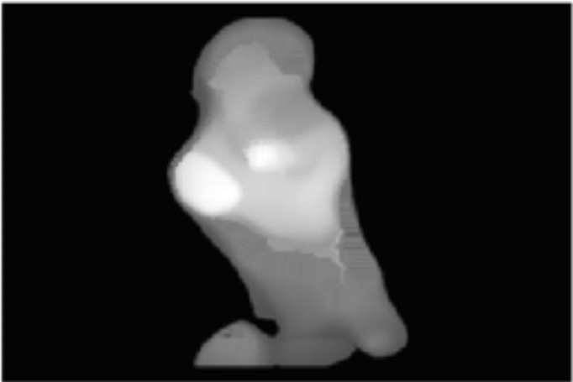
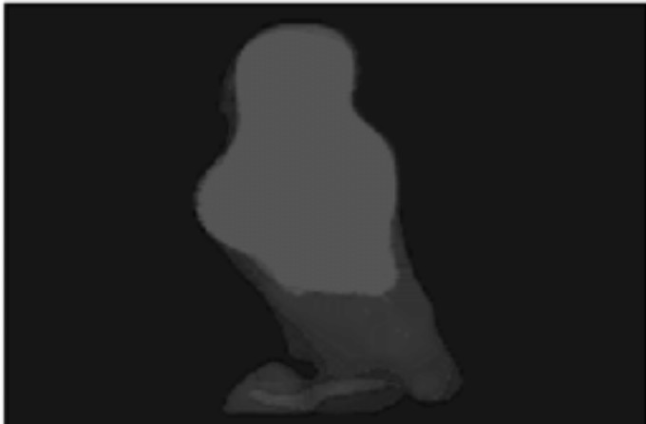
Average Pooling
Max pooling: the strongest pattern signal in a window
Average pooling: replace max with mean in max pooling
The average signal strength in a window
Max pooling Average pooling
Slide credit: Alex Smola and Mu Li (Berkley)

Slide 15
2-D Max Pooling
Returns the maximal value in the sliding window
max(0,1,3,4) = 4
Slide credit: Alex Smola and Mu Li (Berkley)

Slide 16
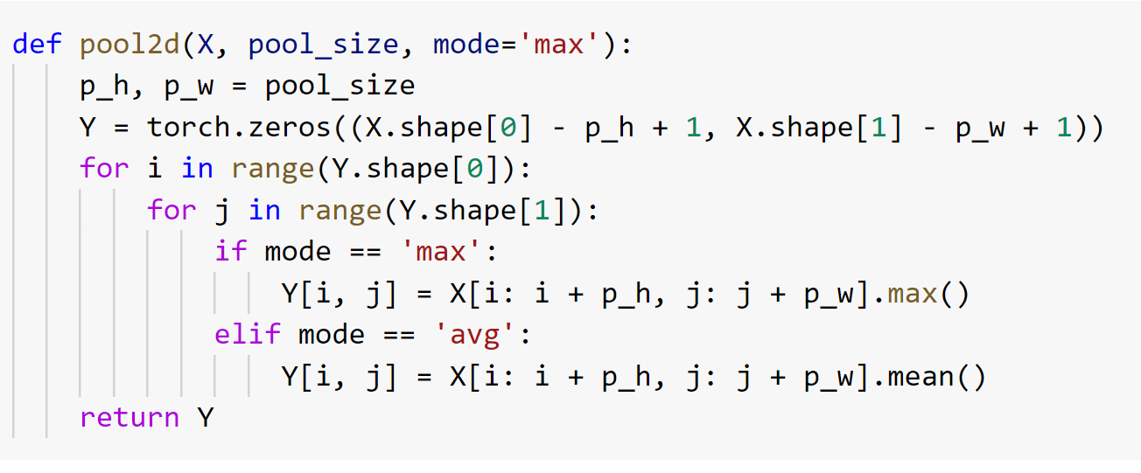
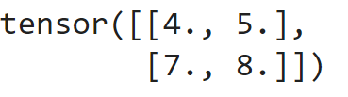
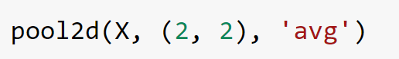
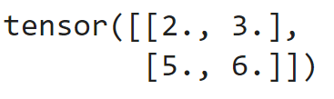
2-D Max Pooling - Code

Slide 17
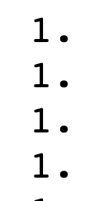
2-D Max Pooling
Returns the maximal value in the sliding window
Vertical edge detection Conv output 2 x 2 max pooling
Tolerant to 1 pixel shift
Slide credit: Alex Smola and Mu Li (Berkley)

Slide 18
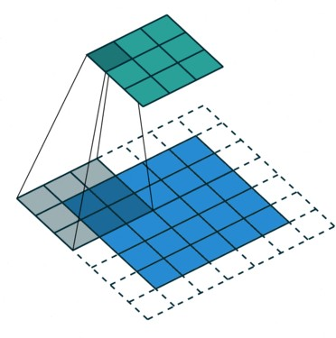
Padding, Stride, and Multiple Channels
Pooling layers have similar padding and stride as convolutional layers
No learnable parameters
Apply pooling for each input channel to obtain the corresponding output channel
#output channels = #input channels
Slide credit: Alex Smola and Mu Li (Berkley)

Slide 19
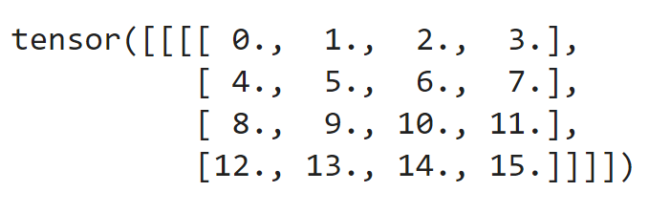
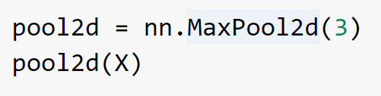
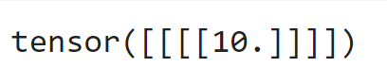
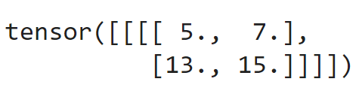
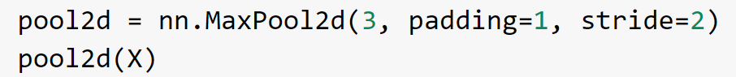
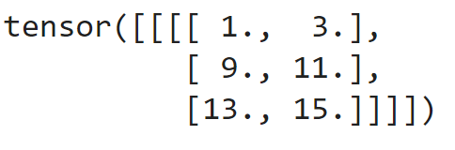
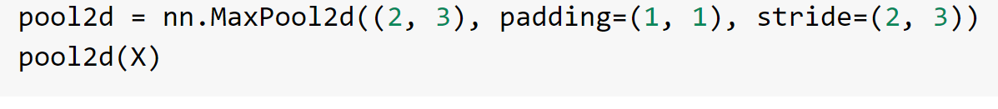
2-D Pooling and Striding
X =
Function assumes a stride shape of (3, 3) by default

Slide 20
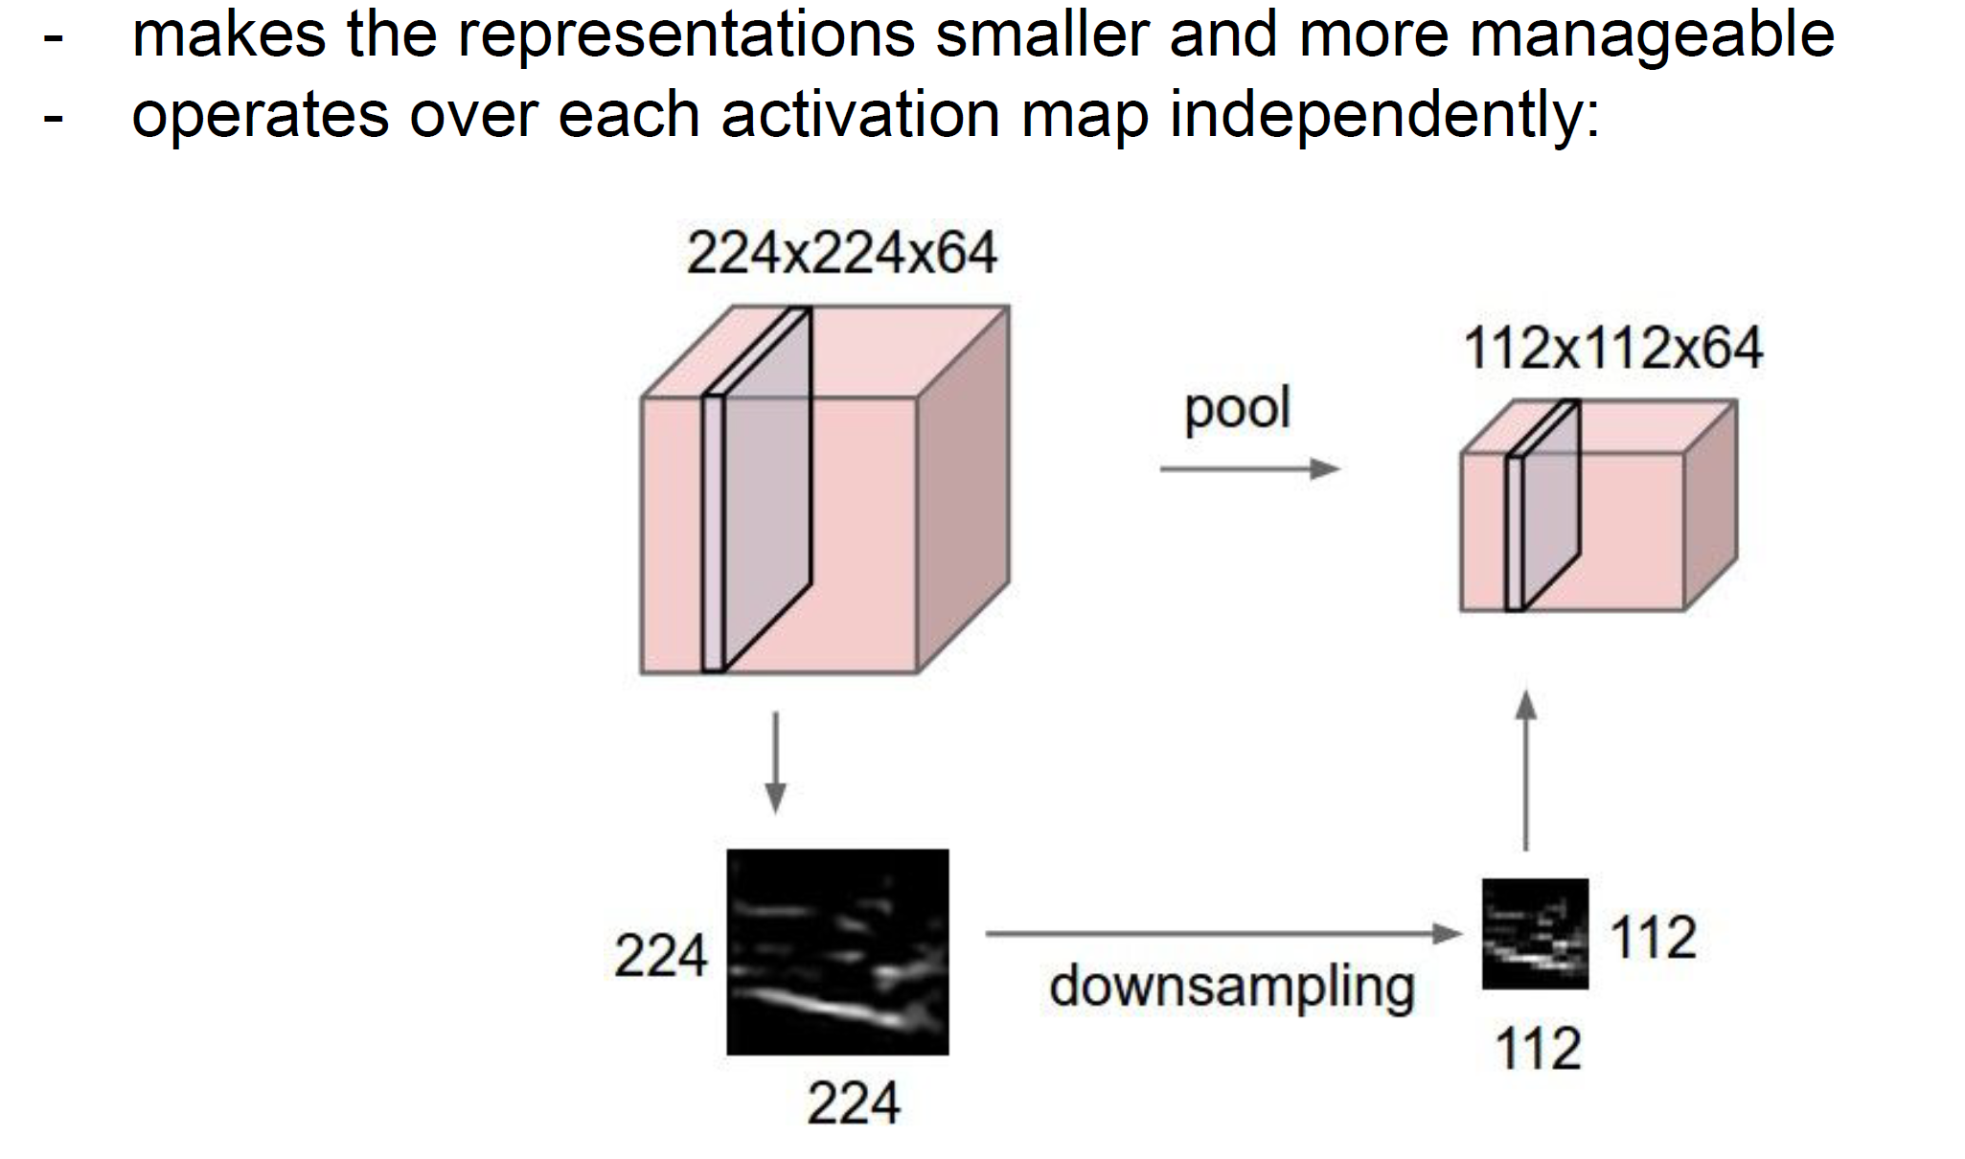
Padding, Stride, and Multiple Channels
Slide credit: Fei-Fei Li, Ranjay Krishna and Danfei Xu (2019)

Slide 21
Padding, Stride, and Multiple Channels
Pooling layers have similar padding and stride as convolutional layers
No learnable parameters
Apply pooling for each input channel to obtain the corresponding output channel
#output channels = #input channels
Slide credit: Alex Smola and Mu Li (Berkley)

Slide 22
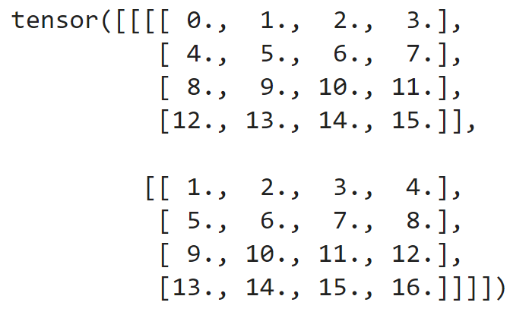
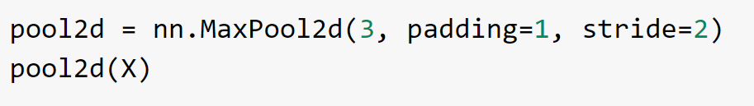
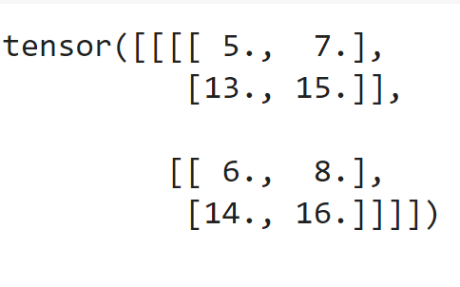
Padding, Stride, and Multiple Channels - Code
X =

Slide 23
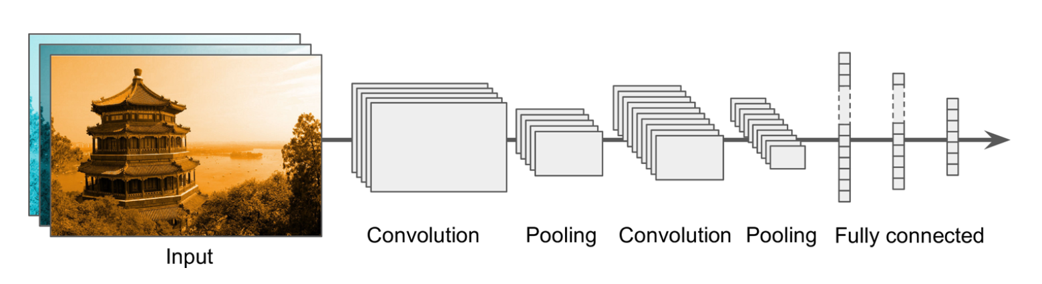
Typical CNN Architecture

Slide 24
Summary
Convolutional layer
Reduced model capacity compared to dense layer
Efficient at detecting spatial pattens
High computation complexity
Control output shape via padding, strides and channels
Max/Average Pooling layer
Provides some degree of invariance to translation
Slide credit: Alex Smola and Mu Li (Berkley)

Slide 25
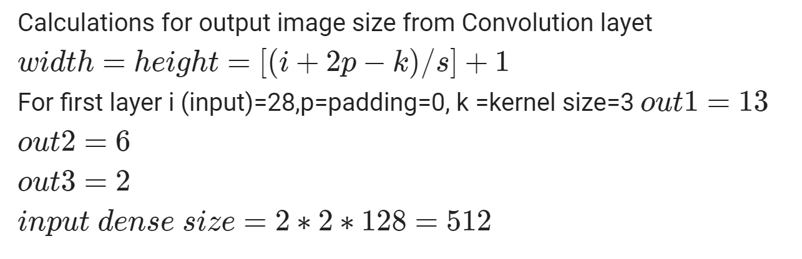
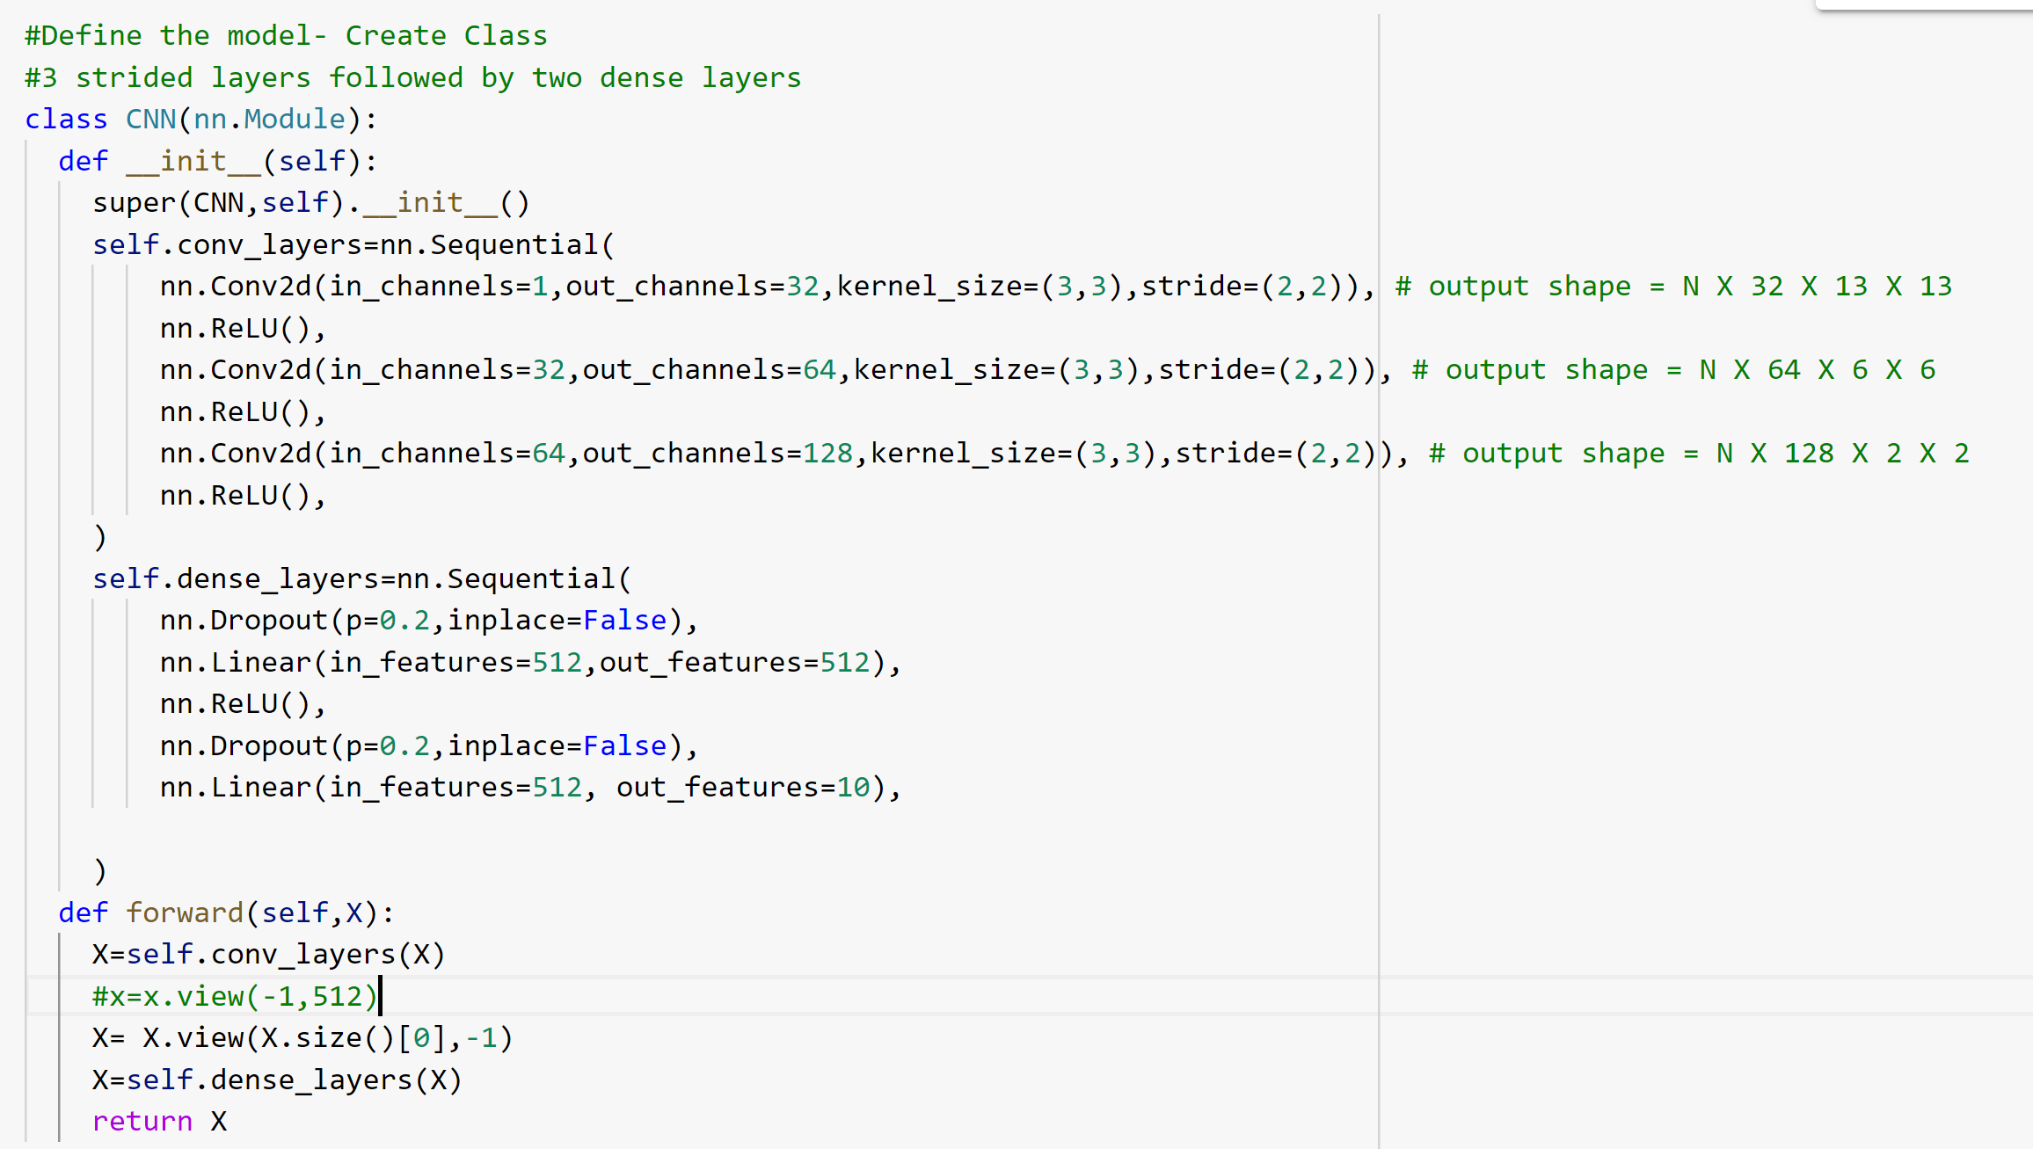
Complete Example

Slide 26
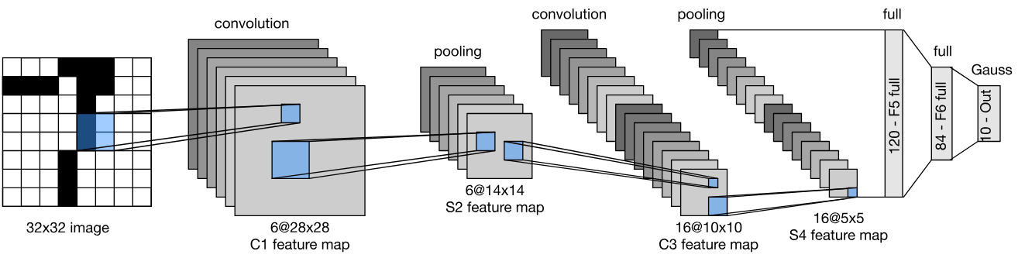
LeNet Architecture
Slide credit: Alex Smola and Mu Li (Berkley)

Slide 27
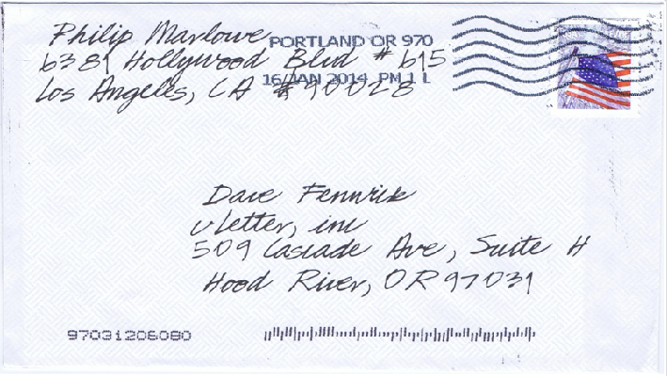
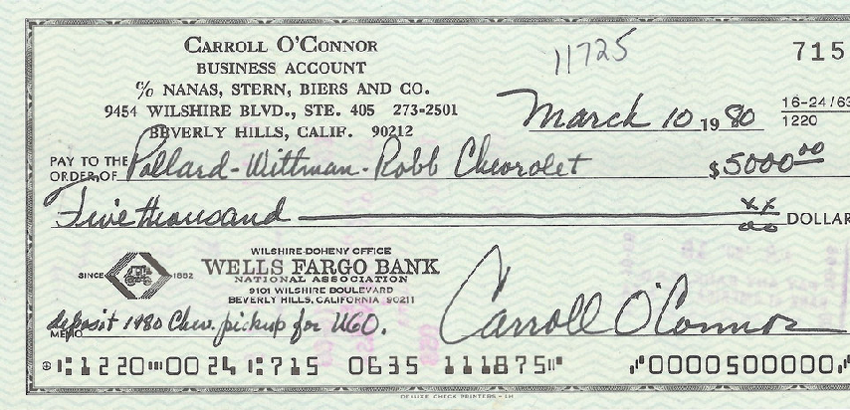
Handwritten Digit Recognition
Slide credit: Alex Smola and Mu Li (Berkley)

Slide 28
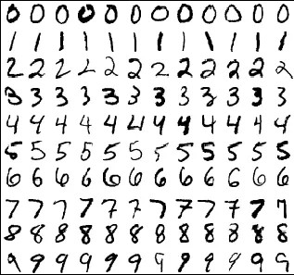
MNIST
Centered and scaled
50,000 training data
10,000 test data
28 x 28 images
10 classes
Slide credit: Alex Smola and Mu Li (Berkley)

Slide 29
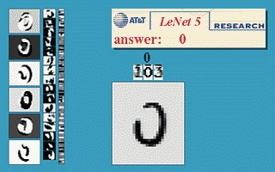
Y. LeCun, L. Bottou, Y. Bengio,
P. Haffner, 1998 Gradient-based learning applied to document recognition
Slide credit: Alex Smola and Mu Li (Berkley)

Slide 30
Expensive if we have many outputs
Slide credit: Alex Smola and Mu Li (Berkley)

Slide 31
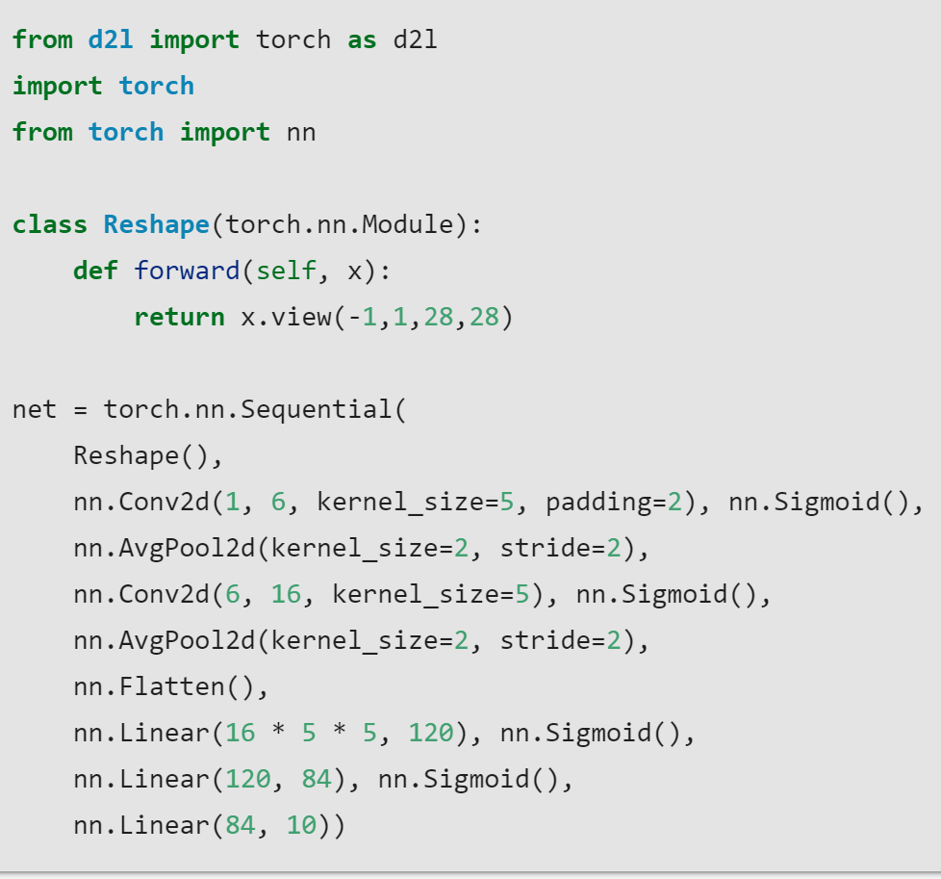
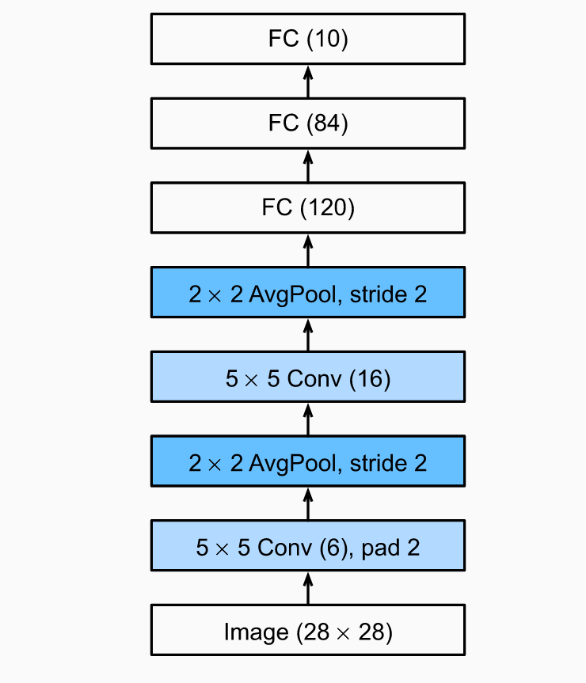
LeNet Architecture- Pytorch Code

Slide 32
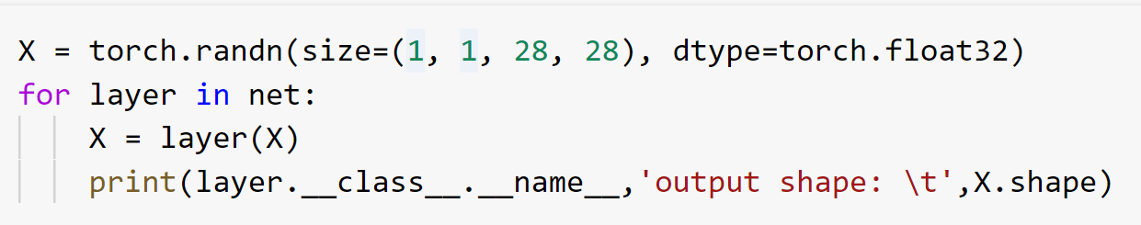

LeNet in PyTorch – Check if the shapes are as expected

Slide 33

AlexNet

Slide 34


Function Classes
2001
Extract features
Pick kernel for similarity
Convex optimization problem
Many beautiful theorems …
courses.d2l.ai/berkeley-stat-157
Slide credit: Alex Smola and Mu Li (Berkley)

Slide 35

Geometry
Extract features
Describe geometry (e.g. multiple cameras) analytically
(Non)Convex optimization problems
Many beautiful theorems …
Works very well in theory when the assumptions are satisfied
2000
courses.d2l.ai/berkeley-stat-157
Slide credit: Alex Smola and Mu Li (Berkley)

Slide 36

Feature Engineering
Feature engineering is crucial
Feature descriptors,
e.g. SIFT (Scale- invariant feature transform), SURF
Bag of visual words (clustering)
Then apply SVM …
(opencv)
courses.d2l.ai/berkeley-stat-157
Slide credit: Alex Smola and Mu Li (Berkley)

Slide 37
Hardware
1970
1980
1990
2000
2010
2020
Data (samples)
10²
(e.g. iris)
10⁴
OCR
₁₀7-8
web
₁₀10
advertising
₁₀12
social nets
10³
RAM
1kB
100kB
10MB
100MB
1GB
100GB
CPU
100kF (8080)
1MF (80186)
10MF (80486)
1GF
(Intel Core)
100GF NVIDIA
>1PF
(8xP3 Volta)
Slide credit: Alex Smola and Mu Li (Berkley)

Slide 38
Hardware
1970
1980
1990
2000
2010
2020
10x
10x
100x
100x 1,000x
Data (samples)
10²
(e.g. iris)
10⁴
OCR
₁₀7-8
web
₁₀10
advertising
₁₀12
social nets
10³
RAM
1kB
100kB
10MB
100MB
1GB
100GB
CPU
100kF (8080)
1MF (80186)
10MF (80486)
1GF
(Intel Core)
100GF NVIDIA
>1PF
(8xP3 Volta)
Slide credit: Alex Smola and Mu Li (Berkley)

Slide 39
Hardware
1970
1980
1990
2000
2010
2020
10x
10x
100x
100x 1,000x
Data (samples)
10²
(e.g. iris)
10⁴
OCR
₁₀7-8
web
₁₀10
advertising
₁₀12
social nets
10³
RAM
1kB
100kB
10MB
100MB
1GB
100GB
CPU
100kF (8080)
1MF (80186)
10MF (80486)
1GF
(Intel Core)
100x 100x
100GF NVIDIA
>1PF
(8xP3 Volta)
10x
10x
10,000x
Slide credit: Alex Smola and Mu Li (Berkley)

Slide 40
Hardware
1970
1980
1990
2000
2010
2020
10x
10x
100x
100x 1,000x
Data (samples)
10²
(e.g. iris)
10⁴
d^{O}e^{C}e^{R}p nets
₁₀7-8
web
₁₀10
advertising
₁₀12
social nets
10³
RAM
1kB
100kB
10MB
100MB
1GB
100GB
CPU
100kF (8080)
1MF (80186)
10MF (80486)
1GF
(Intel Core)
100x 100x
100GF NVIDIA
>1PF
(8xP3 Volta)
10x
10x
10,000x
Slide credit: Alex Smola and Mu Li (Berkley)

Slide 41
Hardware
1970
1980
1990
2000
2010
2020
10x
10x
100x
100x 1,000x
Data (samples)
10²
(e.g. iris)
10⁴
d^{O}e^{C}e^{R}p nets
₁₀7-8
web
₁₀10
advertising
₁₀12
social nets
10³
RAM
1kB
100kB
10MB
100MB 1GB
kernel methods
100GB
CPU
100kF (8080)
1MF (80186)
10MF (80486)
1GF
(Intel Core)
100x 100x
100GF NVIDIA
>1PF
(8xP3 Volta)
10x
10x
10,000x
Slide credit: Alex Smola and Mu Li (Berkley)

Slide 42
Hardware
1970
1980
1990
2000
2010
2020
10x
10x
100x
100x 1,000x
Data (samples)
10²
(e.g. iris)
10⁴
d^{O}e^{C}e^{R}p nets
₁₀7-8
web
₁₀10
advertising
₁₀12
10³
social nets
deep
nets
RAM
1kB
100kB
10MB
100MB 1GB
kernel methods
100GB
CPU
100kF (8080)
1MF (80186)
10MF (80486)
1GF
(Intel Core)
100x 100x
100GF NVIDIA
>1PF
(8xP3 Volta)
10x
10x
10,000x
Slide credit: Alex Smola and Mu Li (Berkley)

Slide 43


ImageNet (2010)
Images | Color images with nature objects | Gray image for hand- written digits
Size | 469 x 387 | 28 x 28
# examples | 1.2 M | 60 K
# classes | 1,000 | 10

Slide 44

AlexNet
SVM
Softmax regression
AlexNet won ImageNet competition in 2012
Deeper and bigger LeNet
Key modifications
Manually engineered features
Features learned by a CNN
Dropout (regularization)
ReLu (training)
MaxPooling
Paradigm shift for computer vision

Slide 45


AlexNet Architecture
AlexNet
LeNet
Larger pool size, change to max pooling
Larger kernel size, stride because of the increased image size, and more output channels.

Slide 46


AlexNet Architecture
AlexNet
LeNet
3 additional convolutional layers
More output channels.

Slide 47


AlexNet Architecture
AlexNet
LeNet
1000 classes output
Increase hidden size from 120 to 4096

Slide 48




More Tricks
Change activation function from sigmoid to ReLu (no more vanishing gradient)
Add a dropout layer after two hidden dense layers (better robustness / regularization)
Data augmentation

Slide 49

Complexity
 | #parameters
 | AlexNet | LeNet
Conv1 | 35K | 150
Conv2 | 614K | 2.4K
Conv3-5 | 3M
Dense1 | 26M | 0.48M
Dense2 | 16M | 0.1M
Total | 46M | 0.6M
Increase | 11x | 1x

Slide 50

Color image: RGB 3 channels
1 | -1 | -1
-1 | 1 | -1
-1 | -1 | 1
-1 | 1 | -1
-1 | 1 | -1
-1 | 1 | -1
1 | -1 | -1
-1 | 1 | -1
-1 | -1 | 1
-1 | 1 | -1
-1 | 1 | -1
-1 | 1 | -1
1 | -1 | -1
-1 | 1 | -1
-1 | -1 | 1
-1 | 1 | -1
-1 | 1 | -1
-1 | 1 | -1
Filter 1
Filter 2
Color image
1 | 0 | 0 | 0 | 0 | 1
0 | 1 | 0 | 0 | 1 | 0
0 | 0 | 1 | 1 | 0 | 0
1 | 0 | 0 | 0 | 1 | 0
0 | 1 | 0 | 0 | 1 | 0
0 | 0 | 1 | 0 | 1 | 0
1 | 0 | 0 | 0 | 0 | 1
0 | 1 | 0 | 0 | 1 | 0
0 | 0 | 1 | 1 | 0 | 0
1 | 0 | 0 | 0 | 1 | 0
0 | 1 | 0 | 0 | 1 | 0
0 | 0 | 1 | 0 | 1 | 0
1 | 0 | 0 | 0 | 0 | 1
0 | 1 | 0 | 0 | 1 | 0
0 | 0 | 1 | 1 | 0 | 0
1 | 0 | 0 | 0 | 1 | 0
0 | 1 | 0 | 0 | 1 | 0
0 | 0 | 1 | 0 | 1 | 0

Slide 51

Convolution v.s. Fully Connected
1 | 0 | 0 | 0 | 0 | 1
0 | 1 | 0 | 0 | 1 | 0
0 | 0 | 1 | 1 | 0 | 0
1 | 0 | 0 | 0 | 1 | 0
0 | 1 | 0 | 0 | 1 | 0
0 | 0 | 1 | 0 | 1 | 0
1 | -1 | -1
-1 | 1 | -1
-1 | -1 | 1
-1 | 1 | -1
-1 | 1 | -1
-1 | 1 | -1
convolution
image
1 | 0 | 0 | 0 | 0 | 1
0 | 1 | 0 | 0 | 1 | 0
0 | 0 | 1 | 1 | 0 | 0
1 | 0 | 0 | 0 | 1 | 0
0 | 1 | 0 | 0 | 1 | 0
0 | 0 | 1 | 0 | 1 | 0
Fully-connected
……
……

Slide 52

1 | -1 | -1
-1 | 1 | -1
-1 | -1 | 1
1
1
Filter 1
2
0
3
0
3
4:
0
1 | 0 | 0 | 0 | 0 | 1
0 | 1 | 0 | 0 | 1 | 0
0 | 0 | 1 | 1 | 0 | 0
1 | 0 | 0 | 0 | 1 | 0
0 | 1 | 0 | 0 | 1 | 0
0 | 0 | 1 | 0 | 1 | 0
…
0
8
1
9
0
10:
0
…
13
6 x 6 image
0
14
0
fewer parameters!
15
Only connect to 9 inputs, not fully connected
1
16
1
…

Slide 53

1 | -1 | -1
-1 | 1 | -1
-1 | -1 | 1
1:
1
Filter 1
2:
0
3:
0
3
4:
0
1 | 0 | 0 | 0 | 0 | 1
0 | 1 | 0 | 0 | 1 | 0
0 | 0 | 1 | 1 | 0 | 0
1 | 0 | 0 | 0 | 1 | 0
0 | 1 | 0 | 0 | 1 | 0
0 | 0 | 1 | 0 | 1 | 0
…
7:
0
8:
1
-1
9:
0
10:
0
…
13:
6 x 6 image
0
14:
0
Fewer parameters
15:
1
16:
1
Shared weights
Even fewer parameters
…

Slide 54


The whole CNN
cat dog ……
Convolution
Max Pooling
Can repeat many times
Fully Connected Feedforward network
Convolution
Max Pooling
Flattened

Slide 55


Why Pooling?
Subsampling pixels will not change the object
bird
bird
Subsampling
We can subsample the pixels to make image smaller
fewer parameters to characterize the image

Slide 56
A CNN compresses a fully connected network in two ways:
Reducing the number of connections
Shared weights on the edges
Max pooling further reduces the complexity

Slide 57
Max Pooling
New image
but smaller
1 | 0 | 0 | 0 | 0 | 1
0 | 1 | 0 | 0 | 1 | 0
0 | 0 | 1 | 1 | 0 | 0
1 | 0 | 0 | 0 | 1 | 0
0 | 1 | 0 | 0 | 1 | 0
0 | 0 | 1 | 0 | 1 | 0
Conv
3
0
-1
1
Max
Pooling
3
1
0
3
2 x 2 image
6 x 6 image
Each filter
is a channel

Slide 58
The whole CNN
3
0
-1
1
Convolution
3
1
0
3
Max Pooling
Can repeat many times
A new image
Convolution
Smaller than the original image
The number of channels is the number of filters
Max Pooling

Slide 59
The whole CNN
cat dog ……
Convolution
Max Pooling
Fully Connected Feedforward network
A new image
Convolution
Max Pooling
Flattened
A new image

Slide 60
Flattening
3
0
1
3
0
-1
1
3
3
1
-1
0
3
Flattened
1
Fully Connected Feedforward network
0
3

